Slide 1
Adapting UI to different screens Windows 10 Developer Workshop

Slide 2
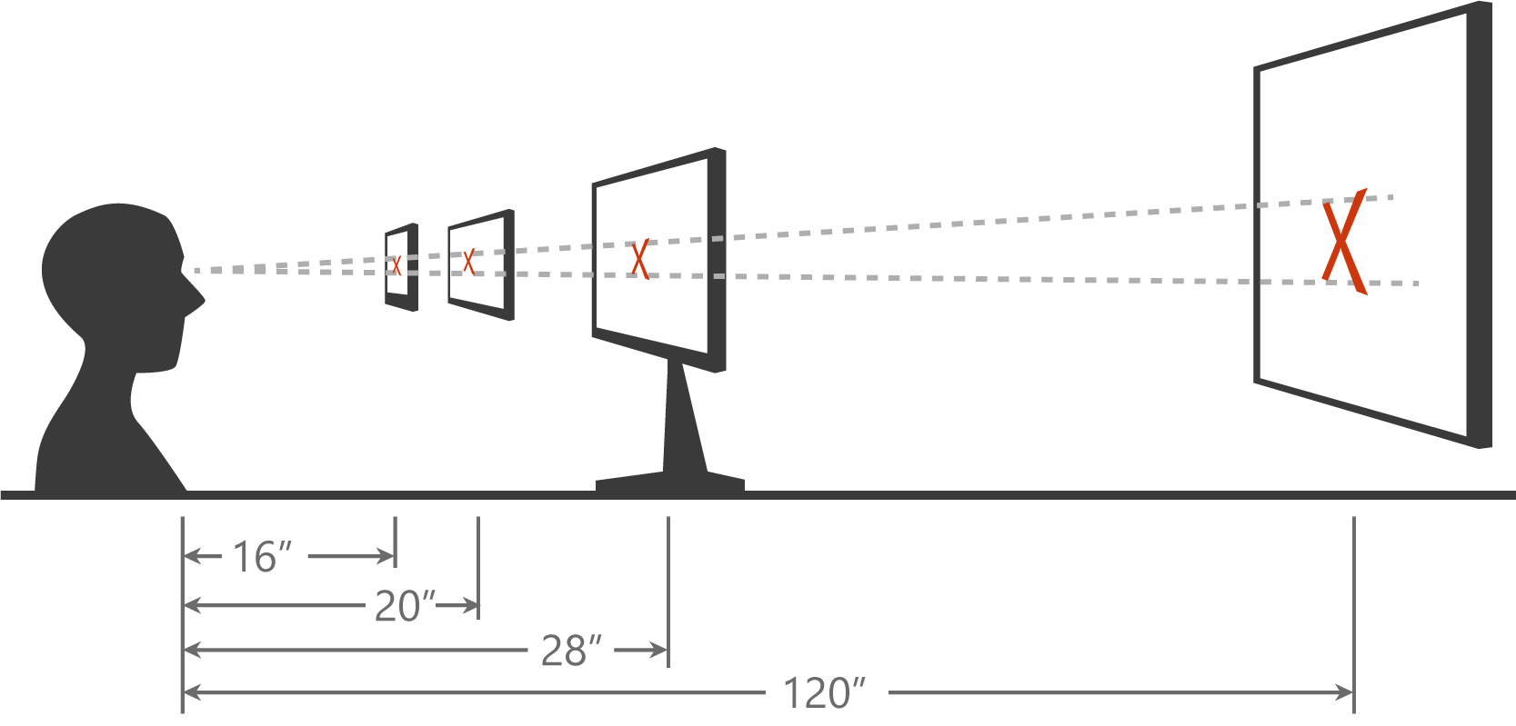
Scaling algorithm
Notes:
The effective pixel system takes into account a number of factors and allows you to layout your pages without having to adjust for the device type or the physical screen resolution.
One factor that determines how large the system will render an item on a particular screen is the scaling algorithm. This takes into account the typical viewing distance of a class of device – a phone is typically held close to the eyes, whereas tablets are held further back, PCs/laptops further back again, and Surface Hub is typically viewed across a room. The scaling algorithm ensures that when you size some UI feature using effective pixels, it will have the same perceivable size regardless if which device it is displayed upon.

Slide 3
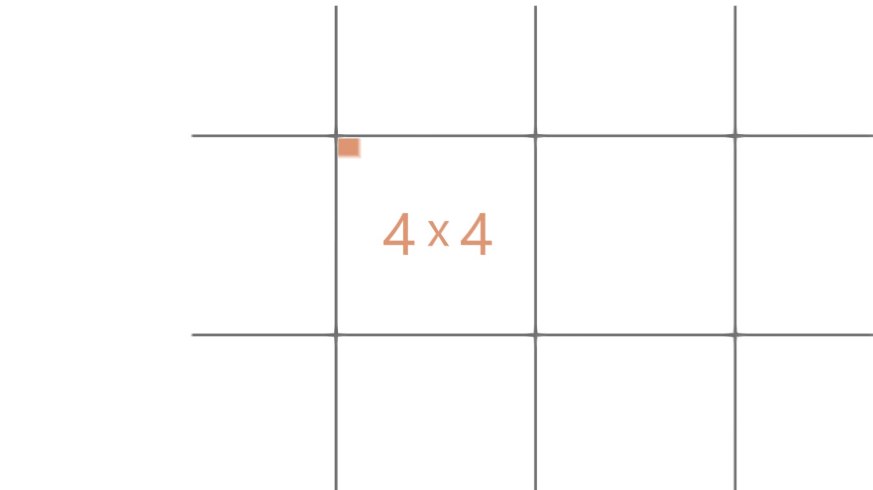
Notes:
Video – This has audio track.
Alternatively, turn off sound and make your own spoken commentary over the video.

Slide 4
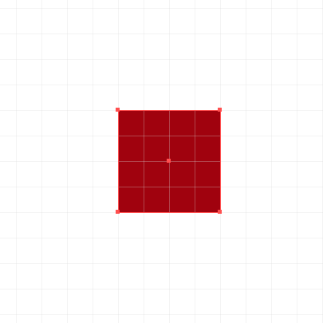
Effective pixel
Physical Pixel
Effective Pixel
Notes:
As you can see, an effective pixel is a logical sizing unit that actually consists of one or more physical pixels.

Slide 5
Ignore scale, resolution, & dpi. Design in Effective Pixels XAML is already in Effective Pixels
Notes:
In UWP XAML, all sizes are in effective pixels. You can ignore viewing distance, screen resolution – just design in effective pixels, confident that your designs will look appropriate whichever screen they display on.

Slide 6
What am I designing?
Notes:
Now let’s consider some guidelines on how to approach the task of creating an adaptive UI that scales well across multiple screen sizes and orientations.

Slide 7
Planning your design
5”
8”
13”
Phone
Viewing Distance: 16.3”
Tablets and 2 in 1
Viewing Distance:
20”
Small and Large Laptops
Viewing Distance:
24.5”
Small and Large Desktop Monitors
Viewing Distance:
28”
TV
Viewing Distance:
84”
Notes:
When you think of the broad range of screen sizes available across all Windows 10 devices, from 4.5” phones up to the 84” Surface Hub, it can seem daunting to create an adaptive UI that will work well across all of these.
Our advice is to target a few key scenarios:
5” phone in portrait
8” tablet in portrait and landscape
13” laptop/PC in landscape
If you focus on these key targets, and use adaptive layout techniques such as Grid layout and controls that can wrap and flow output such as the TextBlock with Wrapping set to true, then you should find that you will end up with good results across all the targeted devices and also on those intermediaries.
You can then target additional screens such as large monitors, Surface Hub or Xbox if it makes sense for your app.

Slide 8
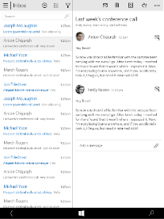
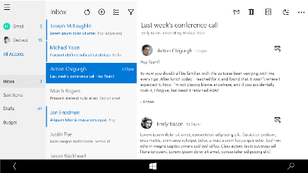
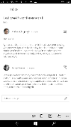
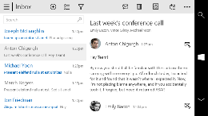
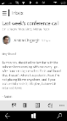
Snap points
epx
320
548
720
1024
phone
phablet & tablet
desktop
Notes:
As you think about what to show on different screens, you will often decide to show more content on larger displays where screen size is not as constrained as on a small screen such as a phone.
A great example is the Mail app. On a desktop display, this adopts a three column layout, with a navigation pane on the left, listing to its right and then perhaps something like a preview pane on the right side of the screen.
As we move down to a phablet or tablet, the layout shrinks to a two-column design. Here, the navigation panel is no longer on the primary layout but has been hidden away and is accessible by a ‘hamburger’ button. The mail listing and the preview pane remains though.
Move down again to a phone display and now the Mail app shrinks again to a one-column layout. The primary screen shows the mail listing, but then to read a mail message, the user taps on an entry in the list and a new page opens to allow reading of the full message.

Slide 9
Demo: Calculator
Notes:
Open the built-in Calculator app on a desktop.
Switch to the scientific layout as this has a richer UI.
Slowly resize the window, showing how parts of the UI are removed as the window size reduces, and that margins and spacing reduces as the screen gets smaller.
Point out that on desktop at the narrowest window, effectively what you are looking at is the Phone display layout.

Slide 10
Design Techniques for Adaptive UI
Notes:
So far, we have identified the need to adjust the content that the user sees on a page according to the size of the display screen. But what techniques should you use for helping to decide what to show and what to hide?

Slide 11
Use standard responsive/adaptive design techniques
1
4
Reposition
Reveal
2
5
Resize
Replace
Reflow
3
6
Re-architect
Notes:
It should be no surprise that the techniques you should use for XAML pages are exactly the same as those used by web designers to create adaptive web pages. What we have done with Windows 10 is bring adaptive web UI techniques to native XAML apps.
Reposition – You can move blocks of content around on the page. For example, in landscape, you can have islands of content extending across the page horizontally, but in a narrow screen layout, move content so that it is laid out more like a single column.
Resize – You can simply allow content on the page to grow and shrink as the window size changes. Using a Grid with proportional column/row sizes is a great way of achieving this.
Reflow – This means to have text, for example, change from a single column on a narrow screen to span two or more columns on wider screens.
Reveal – here you will show additional content areas as the screen width increases, hide them as the screen width decreases.
Replace – With this technique you replace one layout of some content with a different layout depending on the screen size, to ensure a great, screen-appropriate layout on all screen sizes
Re-architect – When you re-architect, you go for a substantially different layout on different size screens, or on different device families. In XAML terms, this often means to navigate to a specific page for some scenario, such as when running on an Xbox, where the user interactions through a controller may be substantially different to the same app running on a PC or phone.

Slide 12
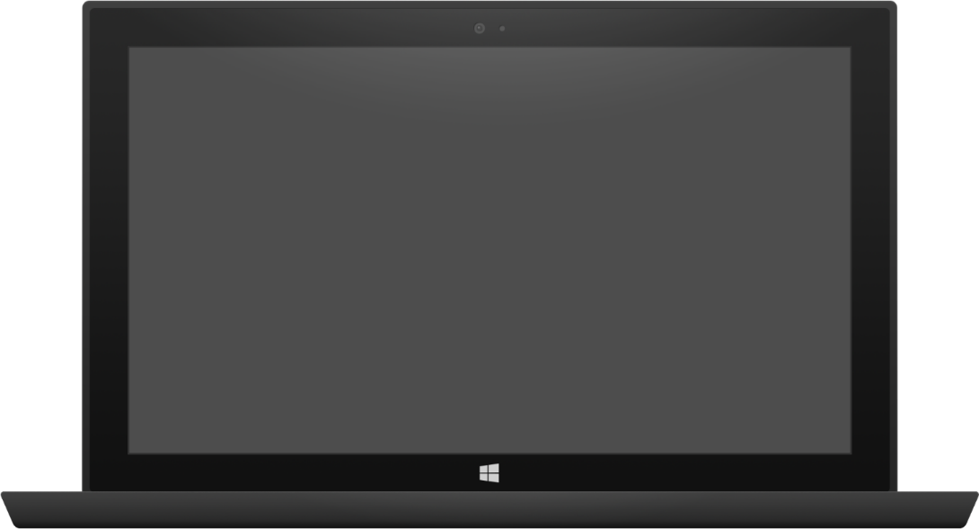
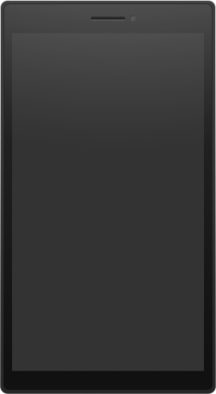
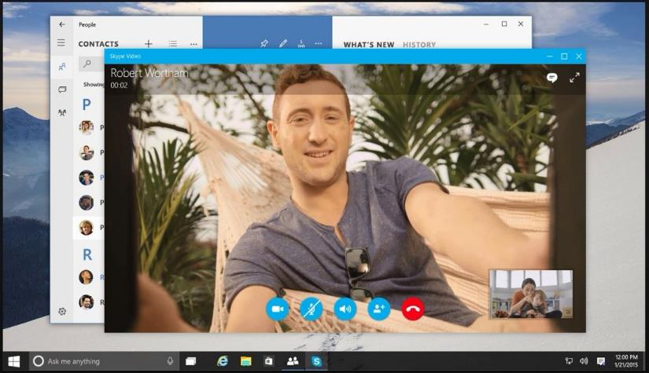

Adaptive design
Build a page that adapts to different screen sizes and orientations
Use Visual States and Adaptive Triggers to change layout
Use RelativePanel to position blocks of content relative to peers, re-positioning in different visual states
Tablet (landscape) / Desktop
Phone (portrait)
Notes:
In many cases, you will use the same display but adapt it using Visual States and – a new feature in UWP XAML - Adaptive Triggers to move content around, or to show/hide bits of content. Another new control, RelativePanel, is great for repositioning content under the control of Visual States – for example, repositioning the ‘End Call’ button underneath the other control buttons on the phone display shown here.

Slide 13
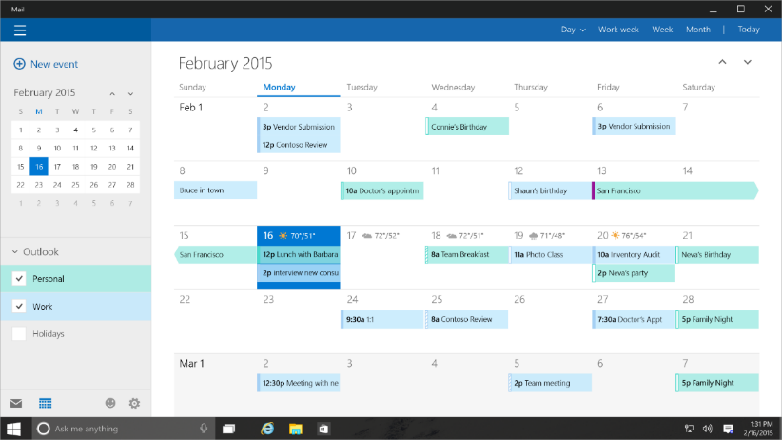
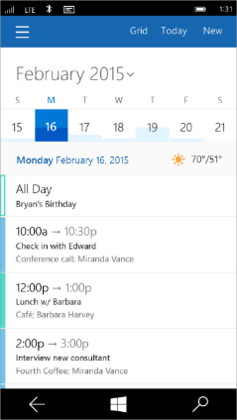
Tailored design
Build unique experiences on different devices
Tablet (landscape) / Desktop
Phone (portrait)
Notes:
Also as you design, think of the way the user interacts with yor app on a particular device. A great example is the calendar app. On a large screen, you will take advantage of the large display area to show a full month date picker, maybe some group selectors, and a rich display such as a full month view.
On a phone however, the user generally glances at their phone to find out what the next few appointments are that day. The primary usage scenario changes. All the information that is conveyed by the large screen display is still available on the phone, but only by navigating through some additional levels of menu and pages.

Slide 14
Lab 3: Building an Adaptive UI

